Slide 1
Where to Build a Hotel?
By: Kishan Patel

Slide 2
Introduction
Hotels play an intricate role in the lives of everyone
Vacations or business trips
Location holds more weight then customer service
Where should one build a hotel in Sugar Land/Houston, Texas area?

Slide 3
Factors
Proximity to:
Restaurants
Parks
Museums
Convention Centers
Good for family vacations, business trips, and casual hangout spots

Slide 4
Data Acquisition and Analysis
Location data was gather from Foursquare of the thirty closest restaurants, parks, museums (there were only four museums in the radius limit), and convention centers to the city of Sugar Land in a 10000-meter radius
The goal was to find the average longitude and latitude values to determine the best place to build a hotel
The reason this approach was taken was because it would output a location that was near all venues found in the dataset

Slide 5
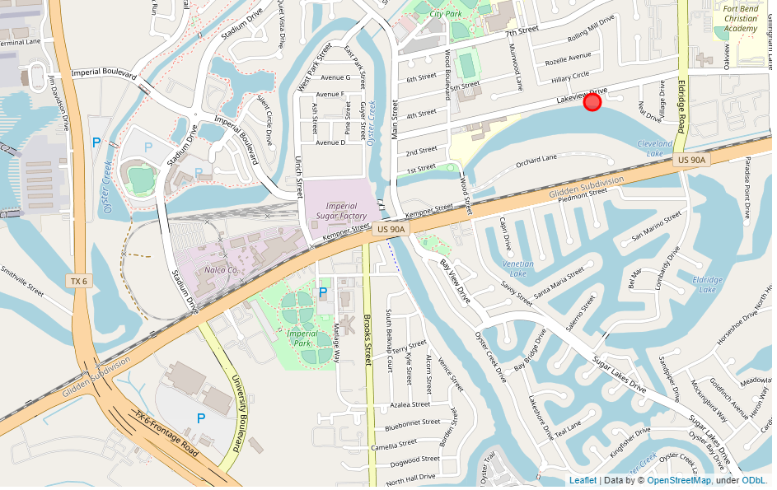
Results
After performing the analysis, it was found that the location of the hotel should be 29.6260414773169 latitude and -95.62335572777322 longitude.

Slide 6
Conclusion
The location is close to a railroad. Thus, if a hotel is built, there needs to be high quality noise proof walls in the structure
It is recommended the hotel is built on Eldridge Road, which is a little east of the actual location found, so it does not interfere with the residential area and it can be seen from
Strong recommendation to build the hotel Highway 90

